Slide 1
Music Genre Prediction
IDS 702 Final Project
Pranav Manjunath Duke University

Slide 2
Acknowledgement
I would like to thank Prof. Akande for his constant support and help throughout the project.

Slide 3



Problem Statement
What are the major music features that impacts the genre of a song?
Build a model that can accurately predict the genre based on these features

Slide 4
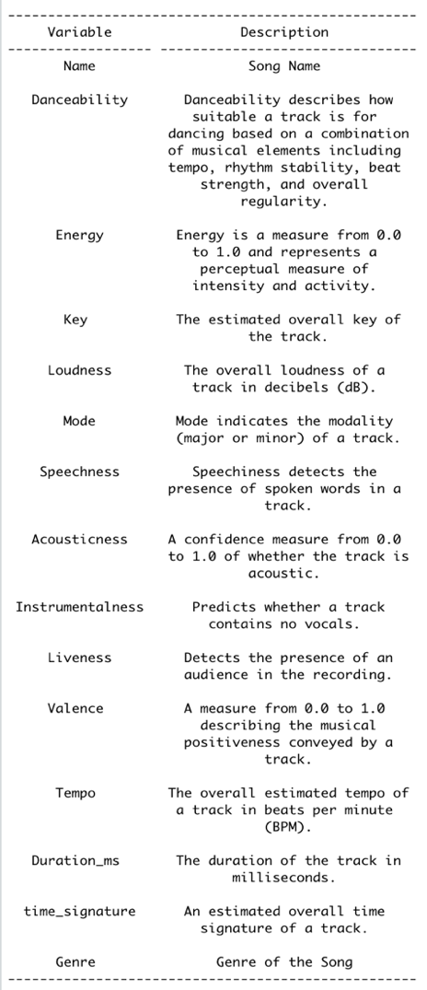
Data
131562 Songs
626 Genres
Removing Duplicate Entries and Combing Genres into its Parent Genre
86446 Songs
38 Genres
Filtering the data with Genres having at least 2000 songs
63302 Songs
8 Genres
https://www.kaggle.com/grasslover/spotify-music-genre-list?select=songDb.tsv

Slide 5


METAL
One – Metallica

Slide 6

ELECTRONIC
Wake Me Up - Avicii

Slide 7

AMBIENT
Ashes to Oceans – Matt Tondut

Slide 8

FOLK
Gaelic Kingdom – Derek Fiechter

Slide 9

HIP - HOP
Rap God - Eminem

Slide 10

JAZZ
These Foolish Things – Lester Young

Slide 11

POP
Beat It – Michael Jackson

Slide 12

ROCK
Paradise City – Guns N’ Roses

Slide 13
Exploratory Data Analysis

Slide 14
Models
Parametric Models
Non Parametric Models
Multinomial Logistic
Regression
Gradient Boosting Methods (GBM)
Train Test Split = 80/20

Slide 15
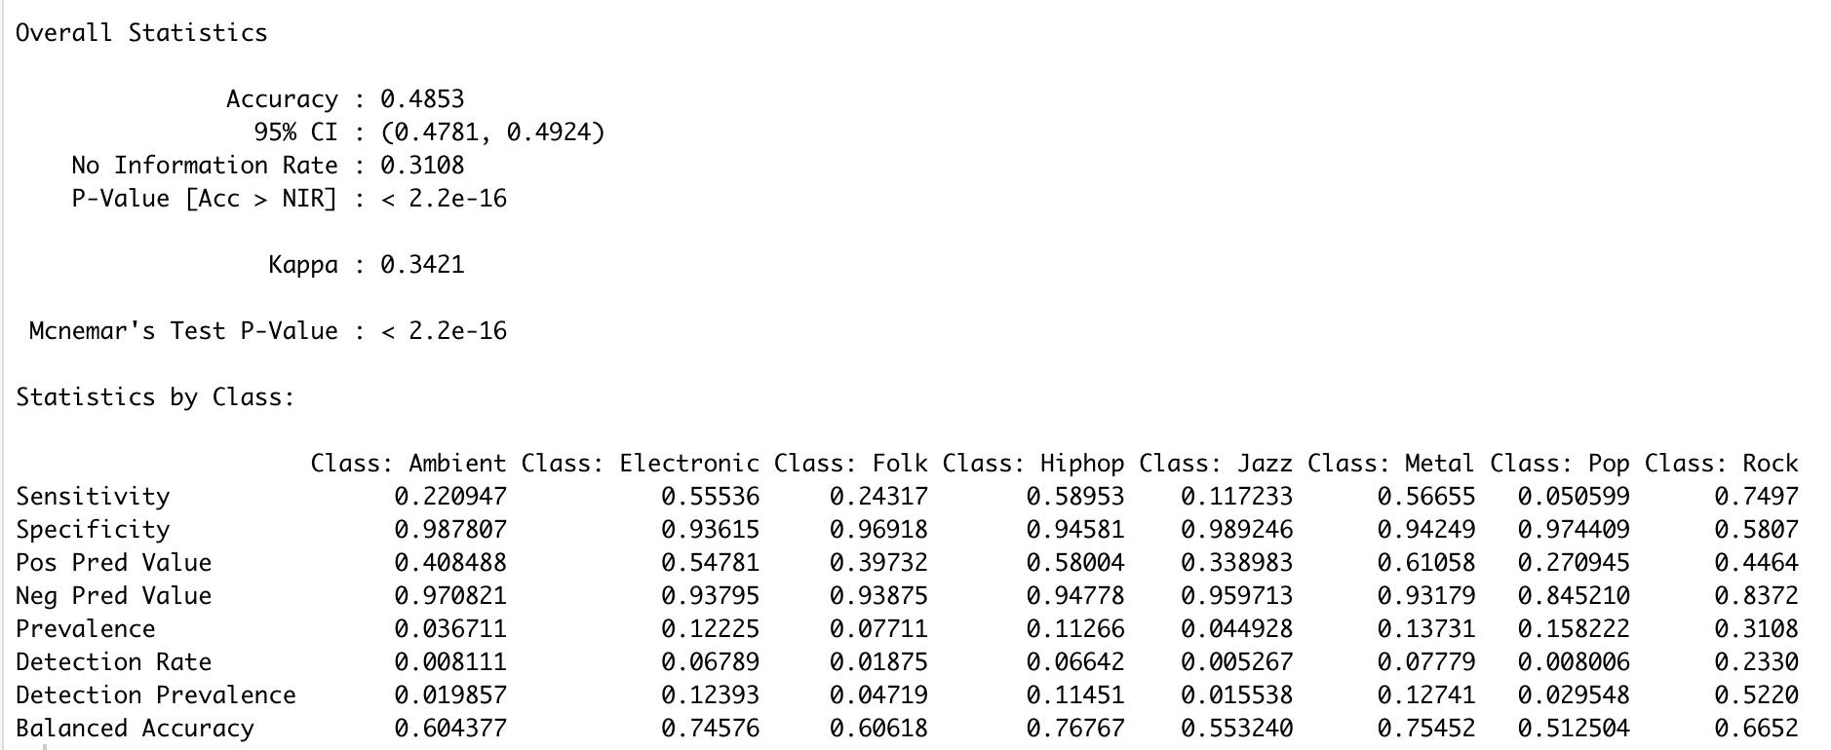
Multinomial Logistic Regression
multinom(Overall_Genre ~ Key + Mode + Danceability + Energy + Loudness + Speechness +
Acousticness + Instrumentalness + Valence+ time_signature + Tempo, data=dTrain)
Accuracy
48.53%

Slide 16
Binned Residual Plots

Slide 17
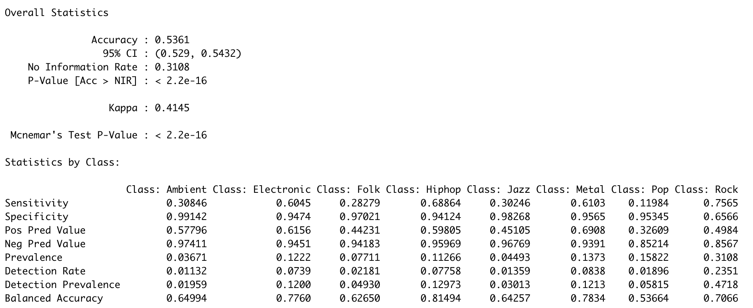
Gradient Boosting Method
gbm(Overall_Genre ~ Key + Mode + Danceability + Energy + Valence + Tempo + Loudness + Speechness + Acousticness + Instrumentalness + time_signature + Duration_ms, data=dTrain, n.trees=500, interaction.depth=2)
Accuracy
53.61%

Slide 18
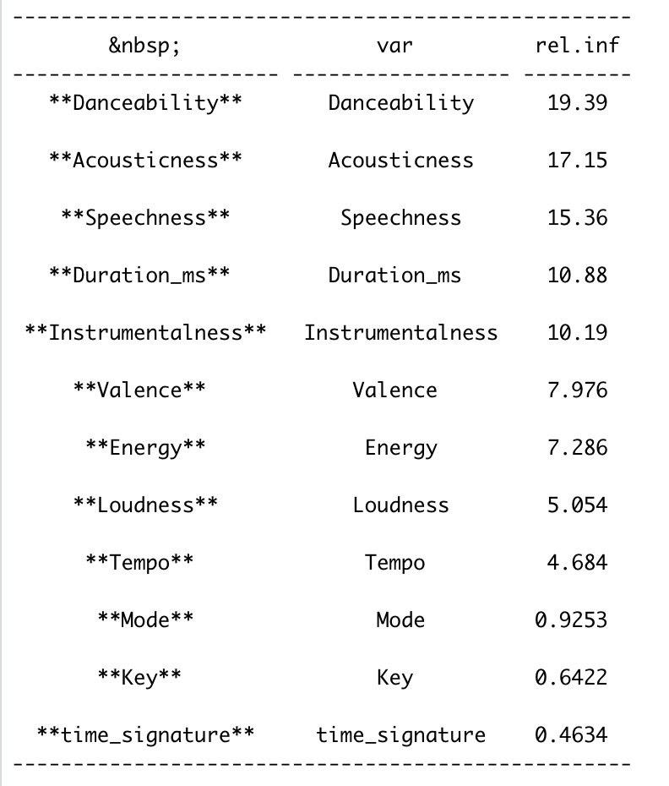
Gradient Boosting Method
Relative Variable Importance

Slide 19
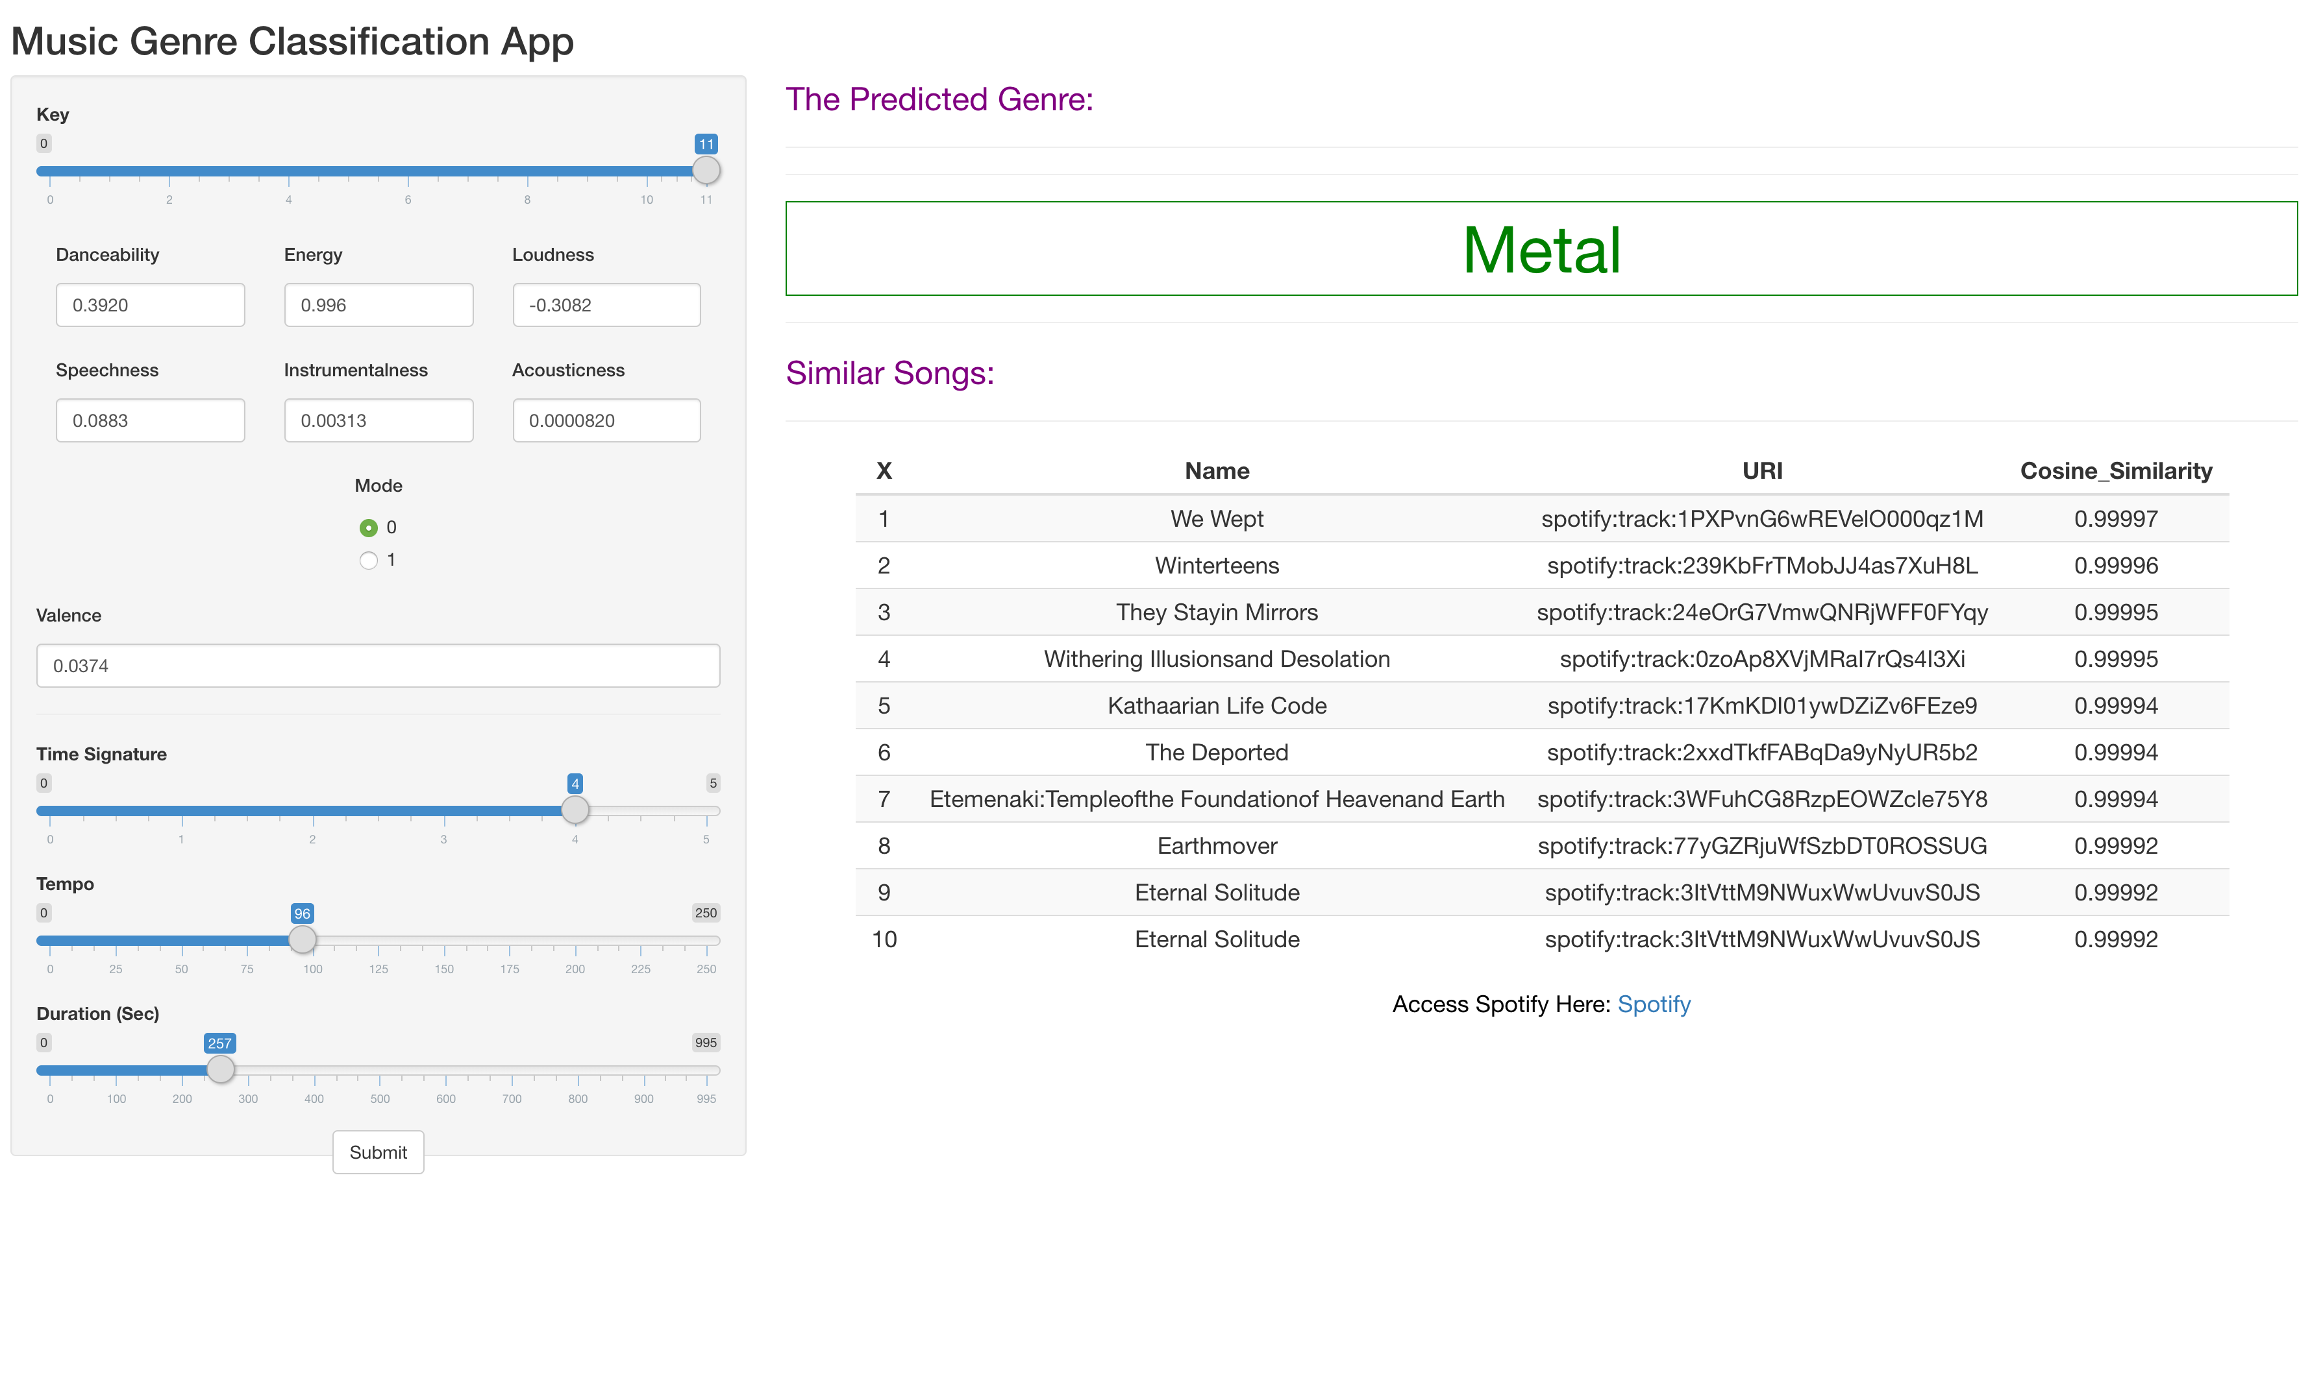

Slide 20
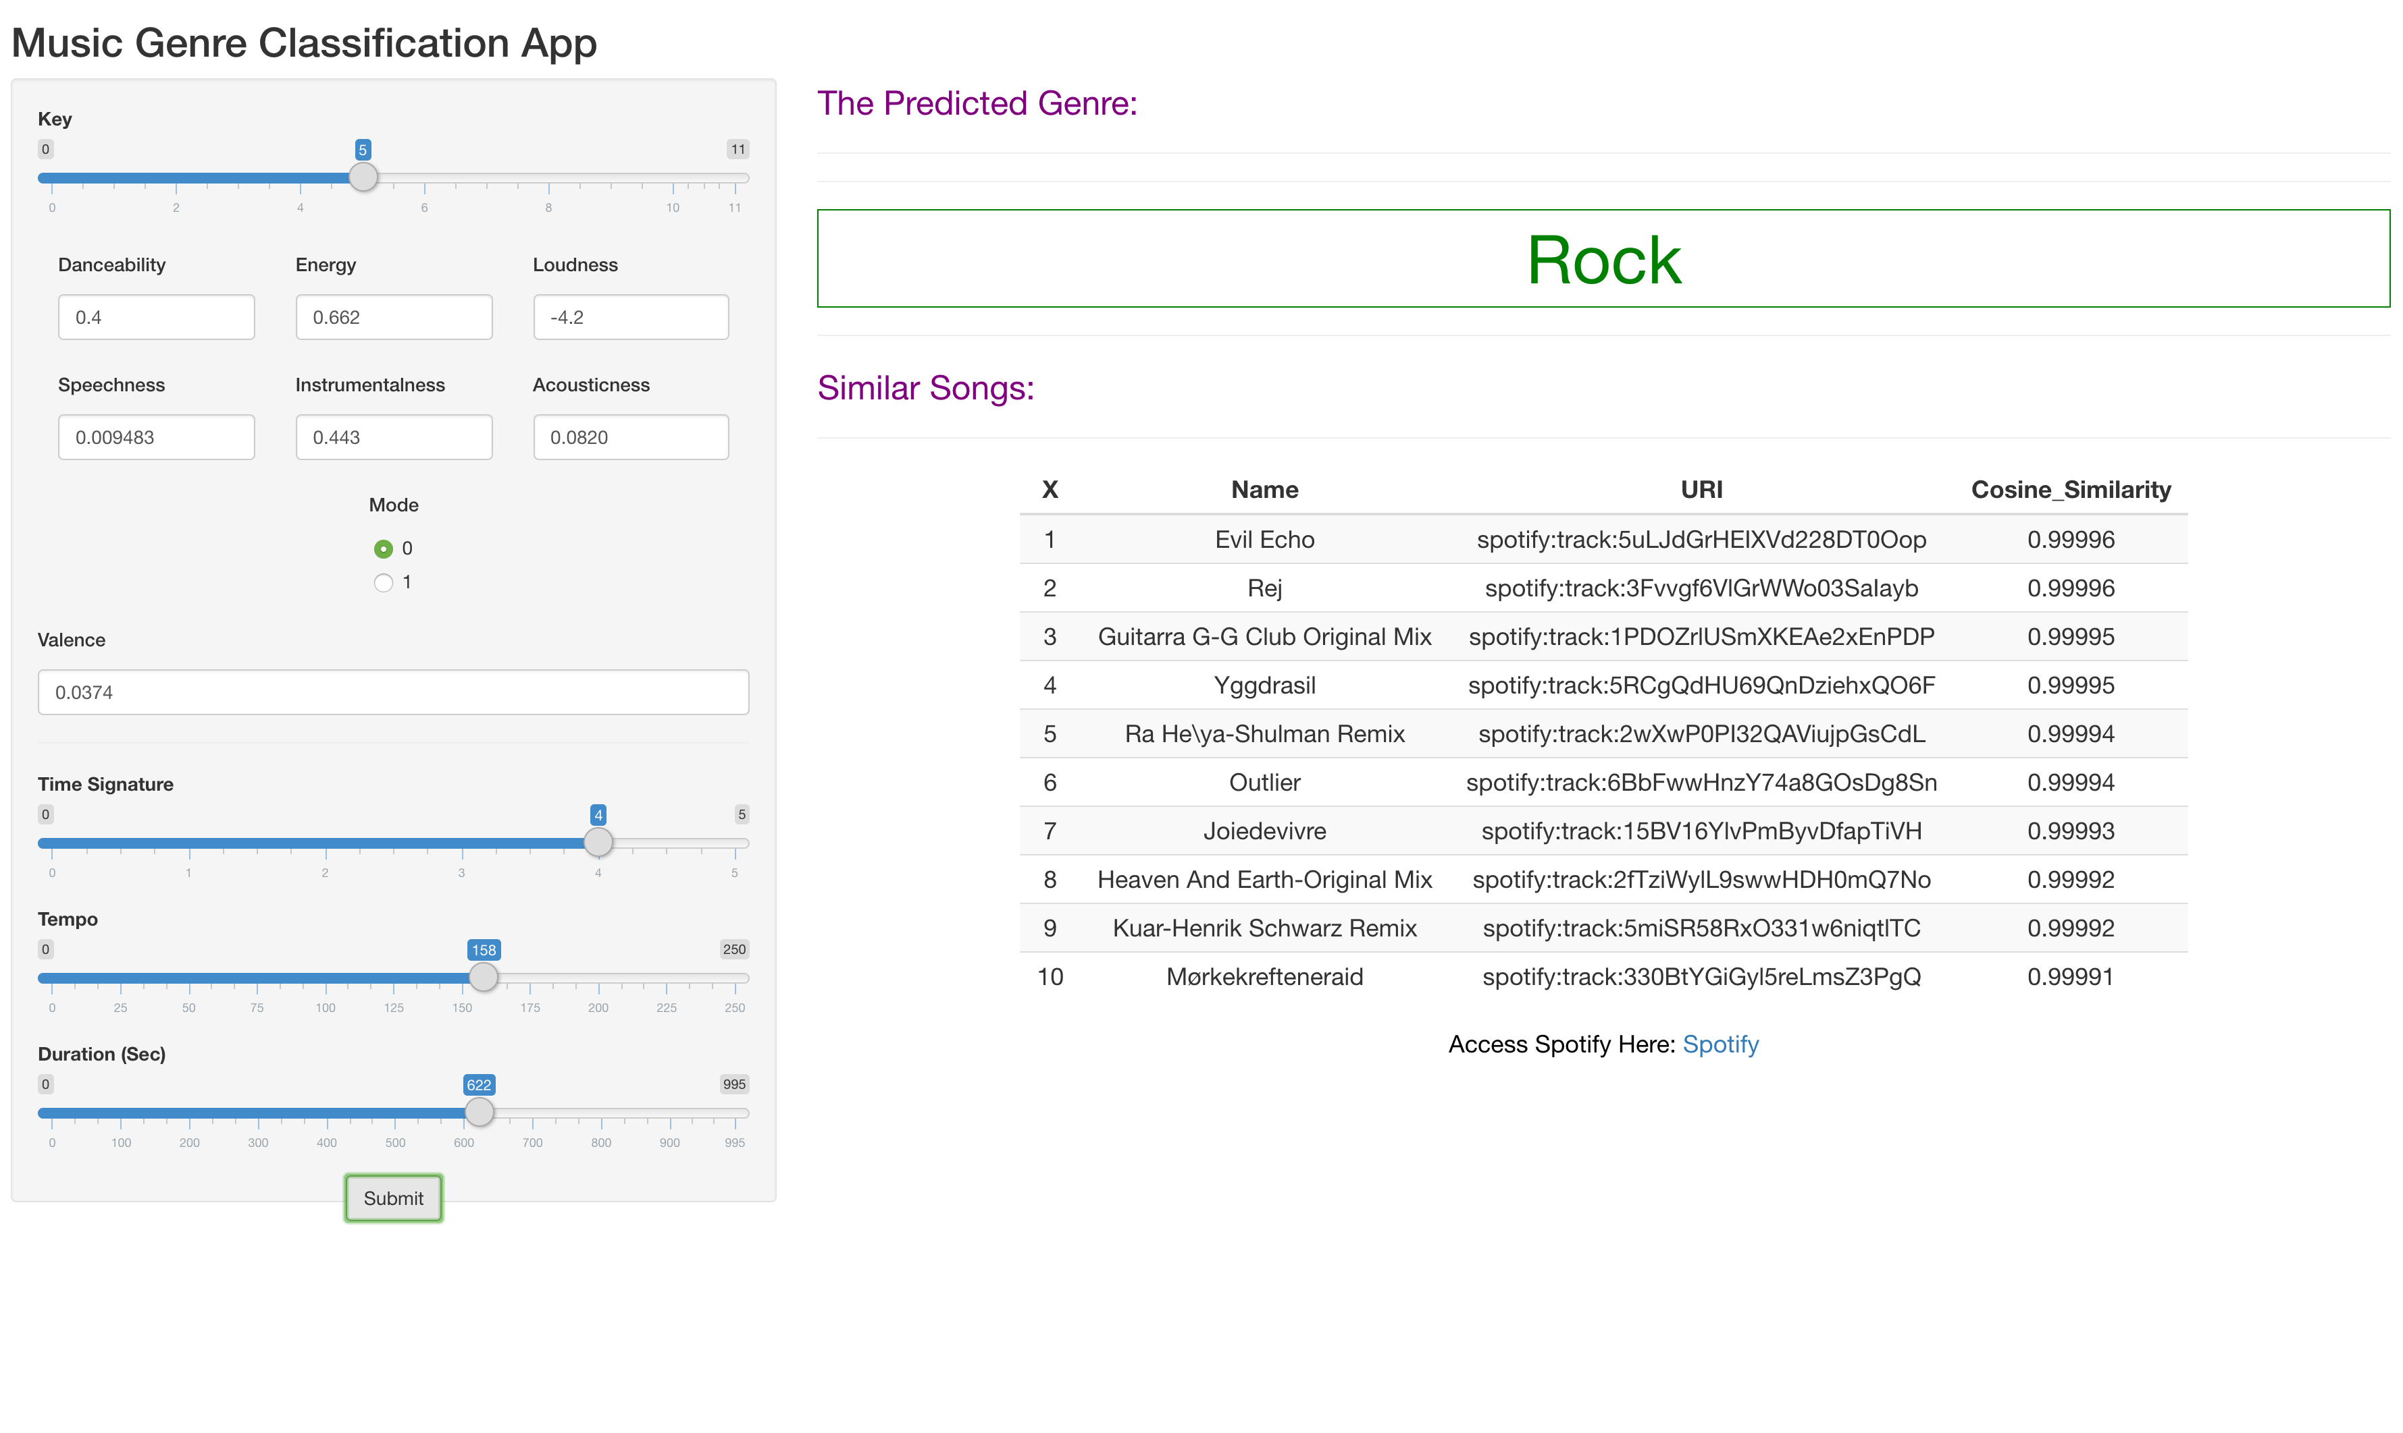

Slide 21


Limitations
There is no clear boundaries for Genres
One Song can belong to many Genres
Genres can also be a combination of two or more Genres (Indie Rock)

Slide 22
Future Scope
Deep Learning Algorithms
Fuzzy Interpretations

Slide 23
Photo Credits
https://www.theclavichord.com/mind-body-soul-how-does-jazz-music-affect-you/
http://niasounds.com/blog/tag/ambient+music
https://scroll.in/article/903086/once-a-popular-tool-for-political-expression-rock-music-is-fading-away-in-bangladesh
https://www.youtube.com/watch?v=DBW-Rq4iEhQ
https://www.pinterest.com/pin/369013763189001822/
https://wallpaperaccess.com/eminem-rap-god
https://www.youtube.com/watch?v=quwZVI5EAxA
https://wallpapercave.com/pop-music-wallpapers
https://www.localsamosa.com/2020/06/20/indie-musicians/
https://www.youtube.com/watch?v=u8IuKh5X3ts
https://web.fe.up.pt/~up201703583/urban.html
https://www.kdnuggets.com/2020/02/deep-neural-networks.html

Slide 24
Thank You

